Slide 1
Customer Segmentation
Cluster Analysis

Slide 2
K-Means Algorithm
K-means allows to divide our scatter plot into categories
Random k points are selected by calculating WCSS and determining the centroid by multiple iterations
New data points are assigned based on their distance from the centroid.

Slide 3
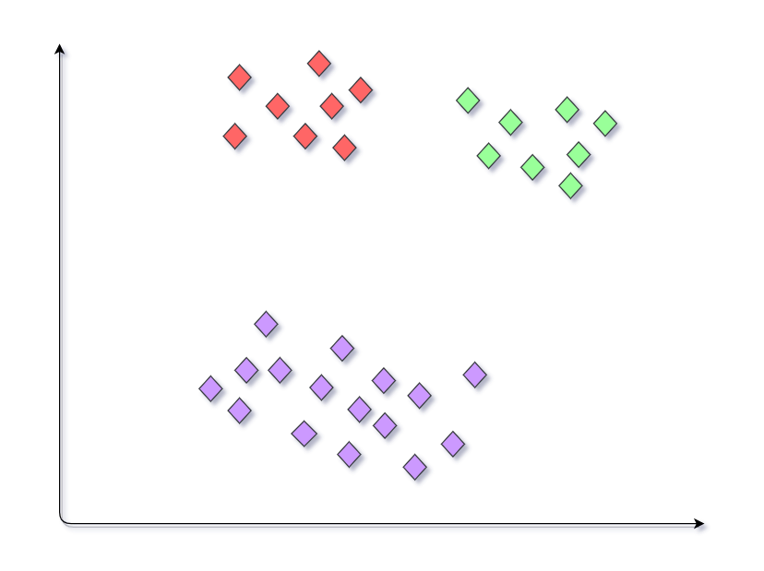
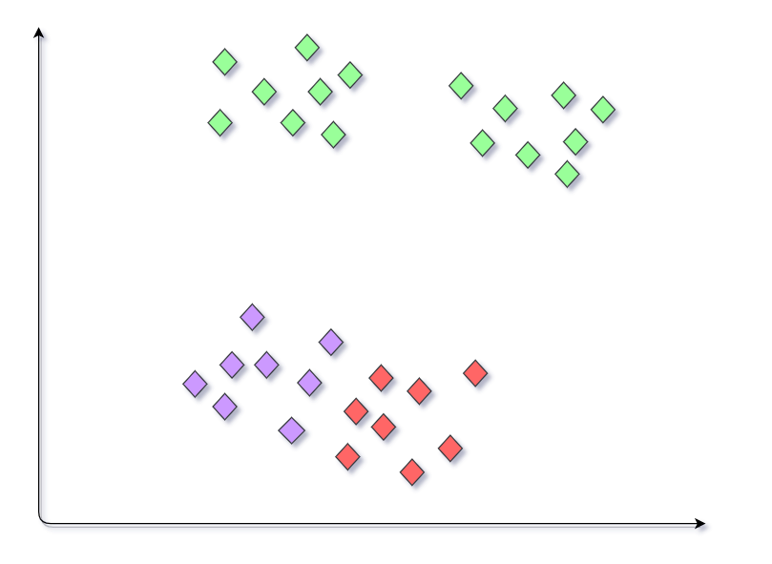
Random initialization trap
When the centroids that are initially chosen vary for obvious clusters, resulting in different results for the same groups.

Slide 4
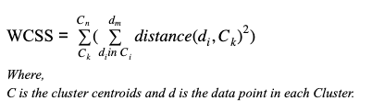
WCSS(Within cluster sum of squares)
The main intuition is to get the minimum sum of squares, and then determine the right number of clusters using the elbow method.

Slide 5
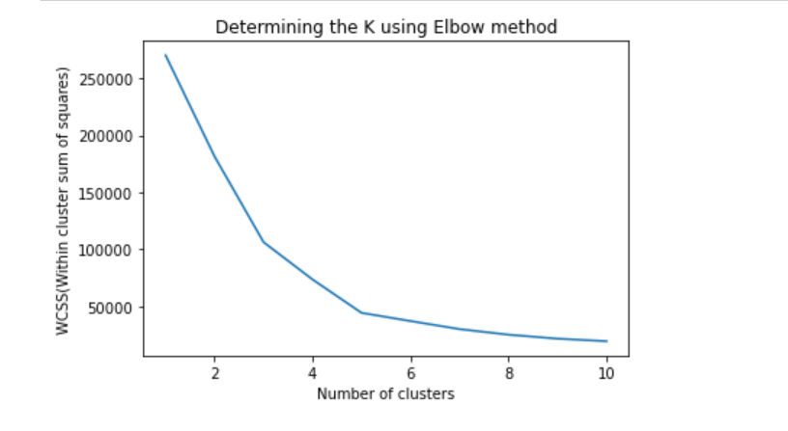
There is a steady decrease in the value of WCSS after k=5, this point is the ideal number of clusters for the given situation.

Slide 6
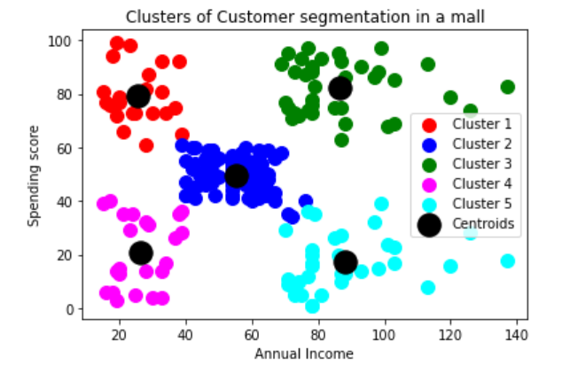
Analysis of clusters
The customers with high incomes and lower spending scores need to be targeted with more offers and advertisements.
As an ethical standpoint, customers with low incomes but high spending scores need to be informed accordingly of their activity.

Slide 7
References
https://analyticsindiamag.com/beginners-guide-to-k-means-clustering/
https://www.geeksforgeeks.org/ml-random-intialization-trap-in-k-means/
Udemy: Machine Learning A-Z on python and R

